Slide 1
Appendix: Python and OpenCV
Python was developed in the 1990s by
Guido van Rossum
○ Versions:
Python 1.1 – 1.5,
Python 1.5.2 (1999.4)
-------------------
Python 3.6.7 (2018.10.20)
-------------------
Python 3.10.2 (2022.1.14)
○ Download
Google → Search “Python”
https://www.python.org/ → Download

Slide 2
○ Installation --
python-3.1.4.msi
windows x86-64
MSI installer (3.1.4)[1](sig)
c:\python31\ …………………………
Finish
Python 3.6.7 (2018.10.20)
○ References
N. Ceder, “The Quick Python Book,
2nd Edition,” 2010.
2. M. Lutz, “Learning Python,” 2013.

Slide 3
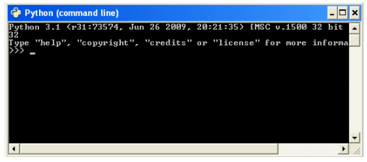
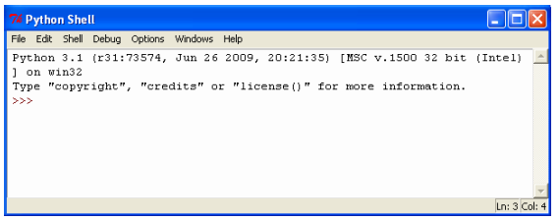
○ Interfaces
Command-line mode
(2) Integrated development environment (IDLE)
(i) Python Shell

Slide 4
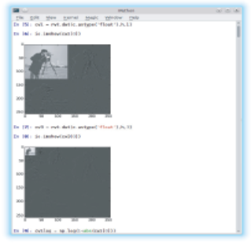
(ii) Ipython: 是一種基於 Python 的互動式直譯器。
相較於原生的 Python Shell，Ipython
提供了更為強大的編輯和互動功能。

Slide 5
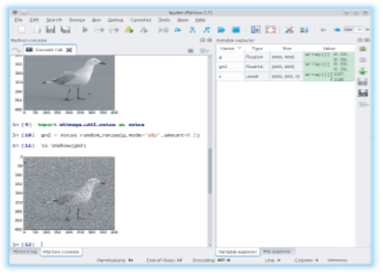
(iii) Spyder: 前身為 Pydee 是一個使用 Python 語言
的開放原始碼跨平台科學運算整合開
發環境 (IDE)。Spyder 整合了函數庫:
NumPy，SciPy，Matplotlib 與直譯器
IPython，以及其他開源軟體。

Slide 6
○ Libraries:
Standard library:
Mathematics, Internet protocols, Multimedia,
System interfaces, File and data handling,
Graphics interface design
Most used libraries:
Scientific library: SciPy
Modules for optimization,
Numerical analysis,
Signal and image processing,
Differential equation solvers.

Slide 7
Numerical library: numpy
Routines for array manipulation,
Functions for operating on arrays.
Plotting library: matplotlib
Plotting tools.
Opencv library: opencv-python
Functions for IP and CV.
○ Installation of libraries:
e.g., pip3 install numpy
pip3 install matplotlib
pip3 install opencv-python

Slide 8
B.1 Basic Use
Prompt: (a) IDLE - >>>, (b) iPython - In [#]:
Arithmetic:
+, -, *, /
// : integer division, ** : exponentiation
^ : bitwise conjunction
Examples:
In : 37+42
Out : 79
In : 2**67 - 1
Out : 147573952589676412927
2-<number>

Slide 9
In : 1.0/7
Out : 0.14285714285714285
In : 11/7
Out : 1
In : 11.0/7
Out : 1.57142857142857714
In : 11.0//7
Out : 1.0
Python returns a value of the same type as
the input
2-<number>

Slide 10
Mathematical functions, in math, must be loaded
(by import) before they are available
In : import math
(import the math library)
In : sqrt(3.0)
Out : 1.7320508075688772
Individual libraries (e.g., sqrt) are called as
(math.sqrt)
In : math.sqrt(3.0)
Out : 1.7320508075688772
2-<number>

Slide 11

Import all libraries from math
In : from math import
In : sqrt(3.0)
Out : 1.7320508075688772
In : sin(pi/6)
Out : 0.49999999999999994
Import library with an alias
In : import math as m
In : m.tan(pi/8)
Out : 0.41421356237309503
2-<number>

Slide 12
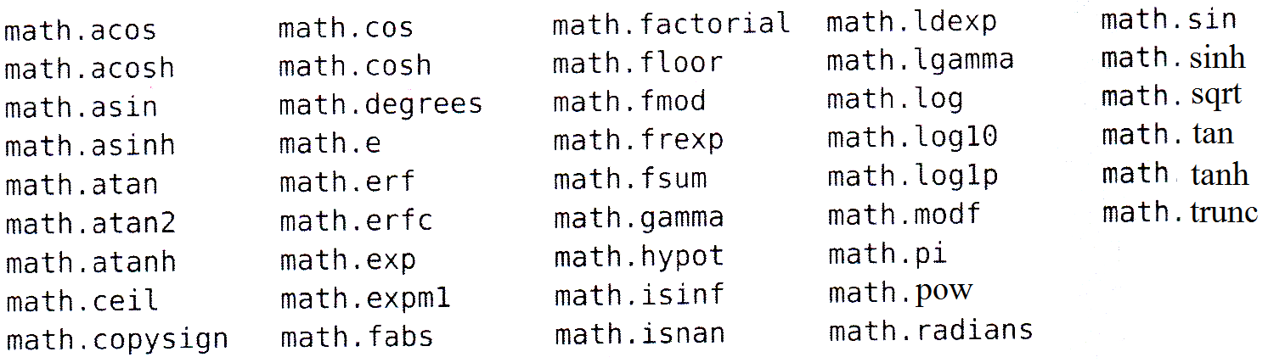
To see all math functions
In : math .tab
B.2 Array Manipulation
Enter an array from numpy
In : import numpy as np
In : A = np.array([[1,2,3], [4,5,6], [7,8,9]])
2-<number>

Slide 13
In : A
Out : array( [ [1, 2, 3],
[4, 5, 6],
[7, 8, 9] ] )
In : print A
Out : [ [1 2 3],
[4 5 6],
[7 8 9] ]
In : A**3
Out : array( [ [ 1, 8, 27],
[ 64, 125, 216],
[343, 512, 729] ] )
2-<number>

Slide 14
In : A**(0.5)
Out : array( [ [1. , 1.41421356, 1.73205081],
[2. , 2.23606798, 2.44948974],
[2.64575131, 2.82842712, 3. ] ] )
In : np.sqrt(A)
Out : array( [ [1. , 1.41421356, 1.73205081],
[2. , 2.23606798, 2.44948974],
[2.64575131, 2.82842712, 3. ] ] )
2-<number>

Slide 15
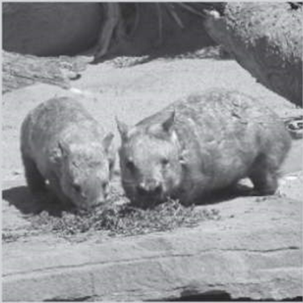
B.3 Image Processing
Input images
In : import skimage.io as io
In : b = io.imread (‘wombats.png’)
This takes the grayscale
image “wombats.pgn”
and puts it into array b.
In : io.imshow (b)
This shows array b as a
grayscale image.
2-<number>

Slide 16
In : b.shape
Out: (384, 331, 3)
See the number of rows, columns, and “pages”
of b, i.e., the stack of three matrices.
In : print b[99, 199, :]
Out: [114, 126, 58]
To see the color values at a pixel.
Output images
In : io.imsave (c, ‘camerman.pgn’)
Write image array c to a PGN image.

Slide 17
B.4 Face Detection
# Import packages
import numpy as np
import argparse
import cv2
# Construct the argument parse and parse the arguments
ap = argparse.ArgumentParser()
ap.add_argument("-i", "--image", required=True,
help="path to input image")
ap.add_argument("-p", "--prototxt", required=True,

Slide 18
help="path to Caffe 'deploy' prototxt file")
ap.add_argument("-m", "--model", required=True,
help="path to Caffe pre-trained model")
ap.add_argument("-c", "--confidence", type=float, default=0.5,
help="minimum probability to filter weak detections")
args = vars(ap.parse_args())
# Load serialized model from disk
print("[INFO] loading model...")
net = cv2.dnn.readNetFromCaffe(args["prototxt"], args["model"])

Slide 19
# Load the input image and construct an input blob for
# the image by resizing to a fixed 300x300 pixels and
# then normalizing it
image = cv2.imread(args["image"])
(h, w) = image.shape[:2]
blob = cv2.dnn.blobFromImage(cv2.resize(image,
(300, 300)), 1.0,
(300, 300), (104.0, 177.0, 123.0))
# Pass the blob through the network and obtain the
# detections and predictions

Slide 20
print("[INFO] computing object detections...")
net.setInput(blob)
detections = net.forward()
# Loop over the detections
for i in range(0, detections.shape[2]):
# Extract the confidence (i.e., probability) associated
# with the prediction
confidence = detections[0, 0, i, 2]
# Filter out weak detections by ensuring `confidence`
# is greater than the minimum confidence
if confidence > args["confidence"]:

Slide 21
# Filter out weak detections by ensuring `confidence`
# is greater than the minimum confidence
if confidence > args["confidence"]:
# Compute the (x, y)-coordinates of the bounding
# box for the object
box = detections[0, 0, i, 3:7] * np.array([w, h, w, h])
(startX, startY, endX, endY) = box.astype("int")
# Draw the bounding box of the face along with the
# associated probability
text = "{:.2f}%".format(confidence * 100)

Slide 22
y = startY - 10 if startY - 10 > 10 else startY + 10
cv2.rectangle(image, (startX, startY), (endX, endY),
(0, 0, 255), 2)
cv2.putText(image, text, (startX, y),
cv2.FONT_HERSHEY_SIMPLEX, 0.45, (0, 0, 255), 2)
# Show the output image
cv2.imshow("Output", image)
cv2.waitKey(0)
Command line:
$ python detect_faces.py --image rooster.jpg
--prototxt deploy.prototxt.txt \--model res10_300x300_ssd_iter_140000.caffemodel

Slide 23
B.5 影片播放
pip3 install opencv-python
# Import the necessary modules and libraries
import cv2
#讀取影片檔
cap = cv2.VideoCapture("twofaces.mp4")
while True:
ret, img = cap.read()
if ret == False: break
cv2.imshow('img', img)
key = cv2.waitKey(1)
if key==27: break
cap.release()
cv2.destroyAllWindows()

Slide 24
B.6 Gesture Detection
# Import modules and libraries
import cv2
import numpy as np
#fist_cascade = cv2.CascadeClassifier('fist_v3.xml')
#Palm detection by cascaded adaboost
palm_cascade = cv2.CascadeClassifier('palm_v4.xml')
#read previous frame
cap = cv2.VideoCapture(0)
att = list()
vecs = list()

Slide 25
#counter
ACTIVE = 10
PROCESS = 30
acounter = ACTIVE
pcounter = 0
# parameter
ret, frame = cap.read()
(height, width, channel) = frame.shape
if width>1024: frame = cv2.resize(frame, (int(width/2), int(height/2)))
pre_gray = cv2.cvtColor(frame, cv2.COLOR_BGR2GRAY)

Slide 26
def handDetection(frame_gray):
#--hand detection --
att.clear()
#fists = fist_cascade.detectMultiScale(frame_gray, 1.1, 8, 0)
#for fist in fists: att.append(fist)
palms = palm_cascade.detectMultiScale(frame_gray, 1.1, 8, 0)
for palm in palms: att.append(palm)
if len(att)>0: return(True)
else: return(False)

Slide 27
def opticalFlow(frame_gray):
#--optical flow detection--
for (x,y,w,h) in att:
left = x-2*w
right = x+3*w
top = y-2*h
bottom = y+3*h
if left<0: left = 0
if right>width-1: right=width-1
if top<0: top=0
if bottom>height-1: bottom=height-1
subpre = pre_gray[top:bottom, left:right]
subimg = frame_gray[top:bottom,

Slide 28
left:right]
flow = cv2.calcOpticalFlowFarneback(subpre, subimg, None, 0.5, 3, 15, 3, 5, 1.2, 0)
vx = np.average(flow[...,0])
vy = np.average(flow[...,1])
if (vx*vx+vy*vy)>0: vecs.append((vx, vy))
def typeDeterming():
if pcounter == 0: return(0)
if pcounter > 3: return(0)
if len(vecs) == 0: return(0)
allx = []
ally = []
for (vx, vy) in vecs:
allx.append(vx)
ally.append(vy)

Slide 29
sumx = np.mean(allx)
sumy = np.mean(ally)
print(np.std(allx), np.std(ally))
if np.std(allx)>0.5 and np.std(ally)>0.5: return(6) #circle
if abs(sumx)<0.1 and abs(sumy)<0.1: return(5) #hold
if abs(sumx) > abs(sumy):
if sumx > 0: return(1) #right
else: return(3) #left
else:
if sumy > 0: return(2) #down
else: return(4) # up
return(0)

Slide 30
def display(frame, type):
#--display --
cv2.putText(frame, str(acounter), (20, 50), cv2.FONT_HERSHEY_SIMPLEX, 1, (0, 255, 255), 1, cv2.LINE_AA)
if pcounter >0:
cv2.putText(frame, str(pcounter), (20, 80), cv2.FONT_HERSHEY_SIMPLEX, 1, (0, 255, 255), 1, cv2.LINE_AA)
for (x,y,w,h) in att:
center = (x+int(w/2), y+int(h/2))
cv2.ellipse(frame, center, (int(w/2),int(h/2)), 0, 0, 360,
(255, 0, 255), 2)
if pcounter > 0:
cv2.rectangle(frame, (x-2*w, y-2*h), (x+3*w, y+3*h),
(0, 255, 255), 9)

Slide 31
if type == 1: cv2.line(frame, center, (center[0]+2*w, center[1]),
(0, 255, 255), 9)
if type == 2: cv2.line(frame, center, (center[0], center[1]+2*h),
(0, 255, 255), 9)
if type == 3: cv2.line(frame, center, (center[0]-2*w, center[1]),
(0, 255, 255), 9)
if type == 4: cv2.line(frame, center, (center[0], center[1]-2*h),
(0, 255, 255), 9)
if type == 5: cv2.circle(frame, center, w, (0, 255, 255), -1)
if type == 6: cv2.circle(frame, center, 2*w, (0, 255, 255), 9)
cv2.imshow('img', frame)
while True:
ret, frame = cap.read()
if ret == False: break

Slide 32
(height, width, channel) = frame.shape
if width>1024: frame = cv2.resize(frame, (int(width/2), int(height/2)))
(height, width, channel) = frame.shape
frame_gray = cv2.cvtColor(frame, cv2.COLOR_BGR2GRAY)
if pcounter > 0: # in gesture determing
opticalFlow(frame_gray)
pcounter -= 1
else: # in hand detection
if handDetection(frame_gray): acounter -= 1
else: acounter += 1

Slide 33
if acounter < 0: # active gesture determing
vecs.clear()
pcounter = PROCESS
acounter = ACTIVE
if acounter > ACTIVE: acounter = ACTIVE
pre_gray = frame_gray.copy()
result = typeDeterming()
display(frame, result)
k = cv2.waitKey(1)
if k == 27: break
cap.release()
cv2.destroyAllWindows()

